Slide 1


Hospital Management System
Presented by
Muhammad Asif Ayub
Assad Ullah khan

Slide 2


INTRODUCTION
The Hospital Management System (HMS) is designed for Any Hospital to replace their existing manual, paper based system. This System targets to provide complete solution for Hospital and Health care services.
This System can be used in any Hospital, Clinic, Diagnostics or Pathology labs for maintaining patient details and their test results

Slide 3


Add Record
Edit Record
Search Record
Delete
Display
Exit program

Slide 4

Algorithm
Patient Admission
Inserting Patient Data
Ward Allocation
Can Edit Patient Data
Can Search Patient Data
Can Delete Patient Data
Can Display Data

Slide 5

ADD RECORD
Patient Name
Patient Father Name
Patient ID
Patient Birth Year
Ward Assigned
Days of Stay

Slide 6
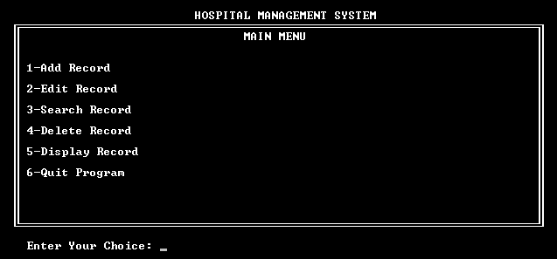
MAIN MENU

Slide 7
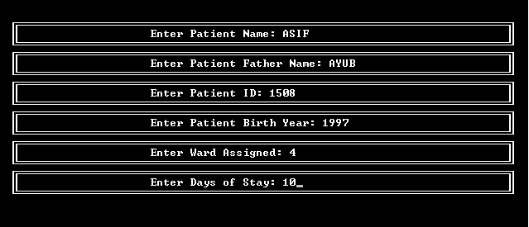
ADD RECORD OF PATIENT

Slide 8
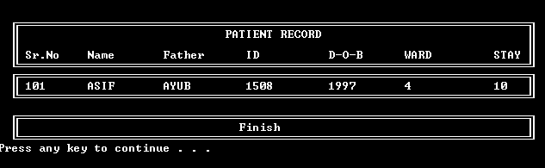
DISPLAY RECORD

Slide 9

Any Question

